Slide 1
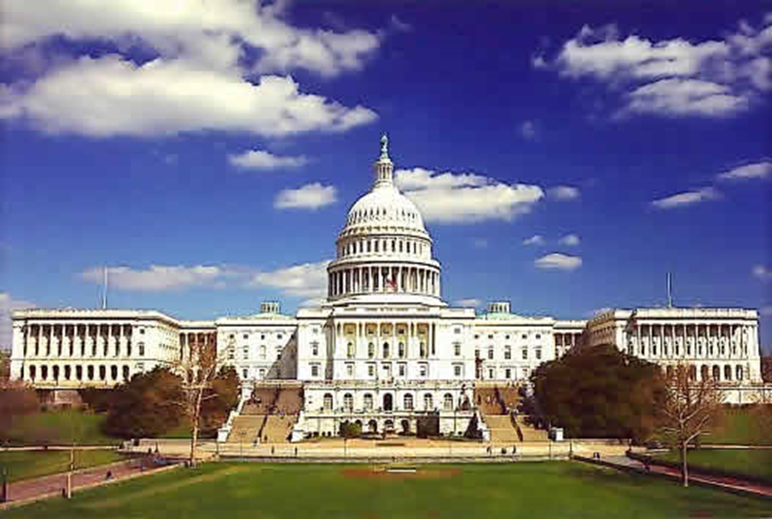
AOTPAC Student Challenge
The powerful student initiative created to increase student involvement in political and legislative advocacy for the occupational therapy profession

Slide 2
AOTPAC Student Challenge
Purpose of Presentation
  To identify the role of AOTPAC
  To learn about the AOTPAC Student Challenge
  To identify the process for participating in the AOTPAC Student Challenge
  To increase awareness of resources available for a successful AOTPAC Student Challenge event

Slide 3
AOTPAC: What is it?
  American Occupational Therapy Political Action Committee (AOTPAC) is the political action arm of AOTA and supports its public policy agenda
  AOTPAC is the financial resource to support legislators who support occupational therapy
    Campaign support for our allies in Congress
    Connecting AOTA members and AOTA Federal Affairs Department with legislators
  AOTA cannot contribute to support legislators and no portion of membership dues can be used for this purpose
Notes:
A political action committee is a group formed by an industry or an issue-oriented organization to raise and contribute money to the campaigns of candidates likely to advance the group's interests
AOTPAC is the political action arm of AOTA that complements AOTA’s public policy agenda & supports its lobbying efforts
By law, AOTA cannot give any financial support to a candidate running for office, none of your AOTA membership dues can be used to support political candidates

Slide 4
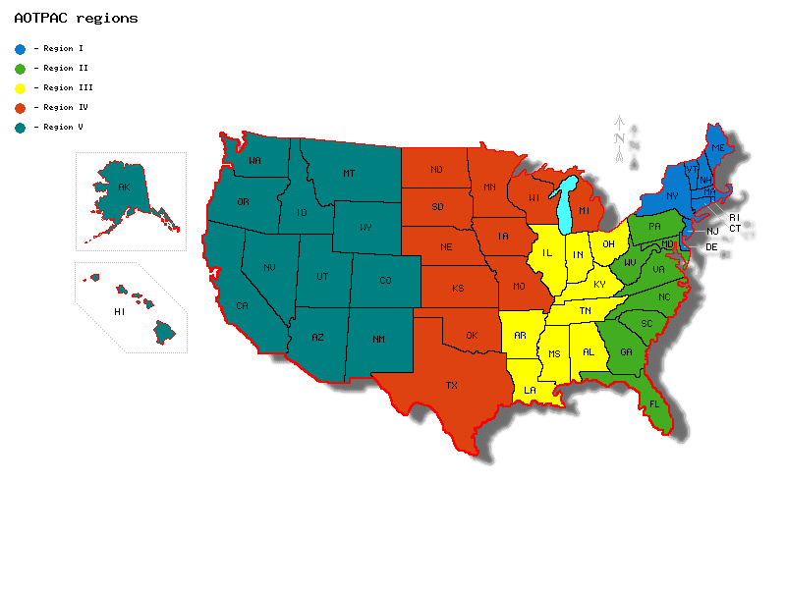

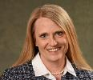




Your AOTPAC Board of Directors - 2021
Region I
Kathleen Weissberg
AOTPAC Chair
Yvonne Randall
Region II
Rachelle Dorne
Region V
Luis Arabit
Region IV
Brent Braveman
Region III
Dawn Sonnier

Slide 5
AOTPAC Student Challenge
  AOTPAC Student Challenge
    An annual fundraising initiative started in 2003 and now sponsored by the Assembly of Student Delegates Steering Committee to encourage student participation in efforts to support AOTPAC.
  Participation
    The AOTPAC Student Challenge encourages Student Occupational Therapy Associations (SOTAs) to participate during each calendar year
    In 2020, twelve (12) SOTA groups participated in the AOTPAC Student Challenge, raising a total of $7,404.90 in much needed funds
Notes:
In 2003 the University of New Mexico SOTA donated $400 to AOTPAC and challenged other student groups to match or beat that donation. It has since become an annual initiative sponsored by the ASD Steering Committee.

Slide 6
  AOTPAC Student Challenge
  Interested? Here are steps you need to know!
1. Brainstorm event ideas
Download “AOTPAC Student Challenge Event Ideas” handout
2. Publicize and host your event
3. Share the outcome of your event
Be in touch with your AOTPAC Board member
4. Send your contribution to AOTPAC
Download the “AOTPAC Student Challenge Contribution Form”
5. Be recognized!
AOTPAC and the entire OT profession thank you for your leadership

Slide 7

  AOTPAC Student Challenge
  Brainstorm fundraising ideas with your SOTA groups.
    Share the “AOTPAC Student Challenge Event Ideas” handout with your SOTA group.
    Review the handout and vote in your meeting! Better yet, contact ASD representatives from last year’s Student Challenge for ideas.

Slide 8

AOTPAC Student Challenge
  Publicize and host your event at your school.
    Your AOTPAC Board member is thrilled to assist you with planning your event. The AOTPAC Board member can also share legislative updates and alert you to additional advocacy opportunities.

Slide 9

AOTPAC Student Challenge
  Share the outcome of your event!
    Share your results with the ASD and be sure to alert your AOTPAC Board member with the outcome. Your successes, no matter how big or small, are important to share with the OT community!
    Consider sending a short recap to your AOTPAC Board member. Sharing your story is an excellent way for AOTPAC to increase participation in the AOTPAC Student Challenge!
Notes:
AOTPAC might post your story and photo or video on the AOTPAC web page.

Slide 10

AOTPAC Student Challenge
  Send your contributions to AOTPAC. Print the “AOTPAC Student Challenge Contribution Form.”
    Send the form and a check payable to “AOTPAC” to:
    Darlene Dennis
    AOTPAC Student Challenge, AOTA
    6116 Executive Blvd., Suite 200
    North Bethesda, MD 20852-4929
    Be sure to contact your AOTPAC Board member with questions. Contact Darlene Dennis with any questions about making your donation.
Notes:
Currently, no online contributions from SOTA groups can be accepted.

Slide 11
AOTPAC Student Challenge
2020 Participants
Casper College, Student OTA Club
Clarkson University, Student OT Association
Creighton University, Student OT Association
James Madison University, Student OT Association
Ohio State University, Student OT Association
Saginaw Valley State University, Student OT Association
San Jose State University, Student OT Association
Stanbridge University, Student OT Association
Temple University, Student OT Association
Texas Women’s University-Houston, Student OT Association
University of Alabama at Birmingham, Student OT Association
University of North Dakota, Casper College, Student OT Association
Will your SOTA be on the list in 2021?

